Slide 1
Inverse procedural Street Modelling: from interactive to automatic reconstruction
Phd Defense : Rémi Cura, 2016/09/12
Université Paris-Est
École Doctorale Mathématiques et Sciences et Technologies
de l'Information et de la Communication (MSTIC)
Jury:
Pr. Christian Heipke (IPI)
Pr. Peter Van Oosterom (TUDelft) Dr. Florent Lafarge (INRIA)
Pr. Gilles Gesquière (LIRIS)
Dr. Julien Perret (IGN)
Dr. Nicolas Paparoditis (IGN)
Dr. Kevin Lyvan (Thales)
Notes:
Parler du context de la these :
Entreprise/labo
Projet terra mobilita

Slide 2
Foreword about this presentation
Work : 3 years
Presentation : 45 minutes
→ compression problem
Lossless
Only a summary, details in the articles/manuscript
High bandwidth: it’s going to be fast, too fast

Slide 3
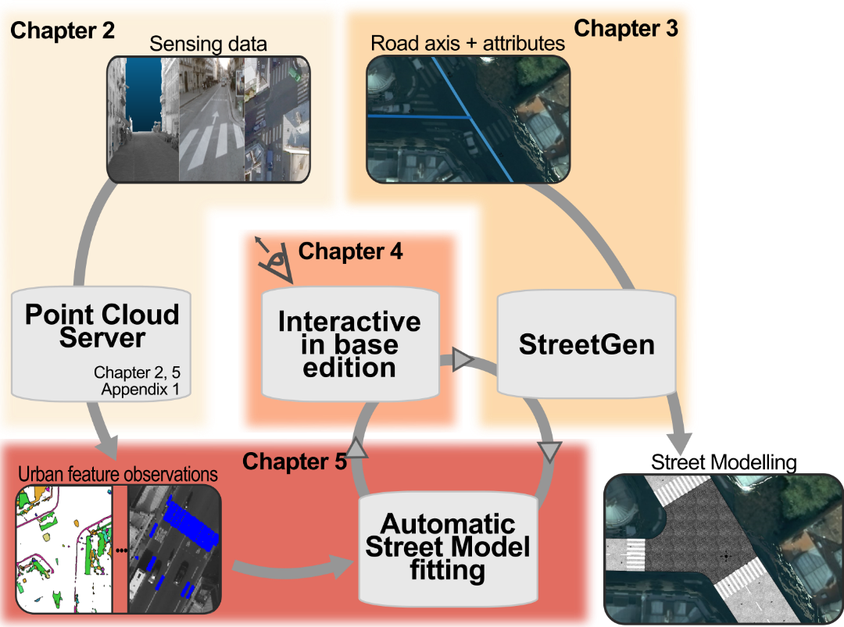
Abstract
Procedural Street Modelling
Todo : replace chapter by presentation order

Slide 4
PLAN
Introduction: Why model streets?
State of the art: How to model streets?
StreetGen :
Generating best guess streets
Editing streets (in-base)
Fitting the street model
Data for observation:
Point Cloud Server
Conclusion (5’)

Slide 5
Introduction
Why model streets?
Usages for street model

Slide 6
Introduction: Streets are important
Cities are important places
Many people live in it
World : 50% in urban area.
France : 80%
Concentrate people/power/usages/issues
Streets are important in cities
In paris, streets area > building area
Streets = medium between people/occupations

Slide 7
Introduction: having a model is important
Modelling the streets
Visualisation (map / 3D model)
Simulation
Analysis
…
Why would we want an accurate, structured, up to date map of streets?
Mapping = maps are classical control/management tools
Map war for South America (Madrid, 1750)
Mapping = visualising: very helpful for human
(demo th. Pythagore visual vs math)

Slide 8
Introduction
Why model streets?
Usages for street model

Slide 9
Introduction: usages for street model
Cities are actually carefully managed
Paris : 100’ of people, one dedicated engineer school
Requires data (precise, up to date)
Visualisation (map / 3D model)
Decision making
Consultation / communication
Simulation
Traffic / pollution / noise / parkings …
Analysis (past/present/planning)

Slide 10
Introduction: usages for city model
Street model ⊂ city model
Many usages for a city model

Slide 11
State of the art
Modelling street, why is it hard?
Existing models

Slide 12
State of the art: modelling street is hard
Even ‘regular’ streets are hard to model
Complex (even for human)
Traffic
Organised
Hard to sense

Slide 13
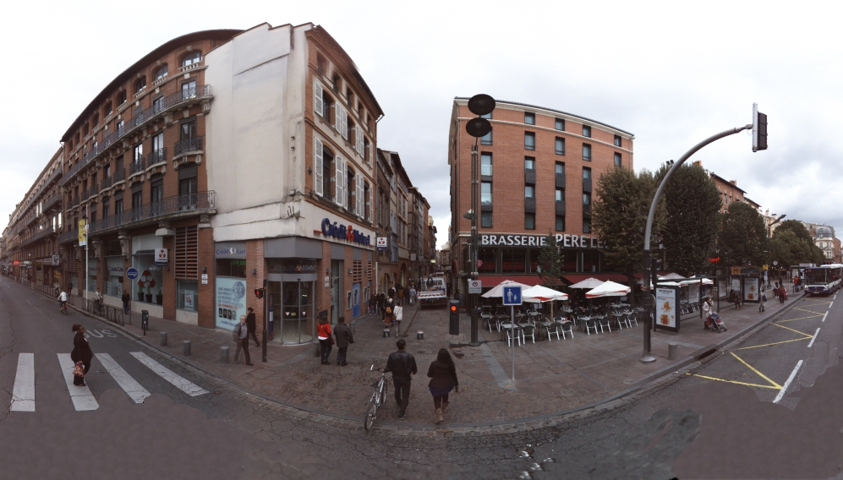
State of the art: modelling street is hard
Streets are complex

Slide 14
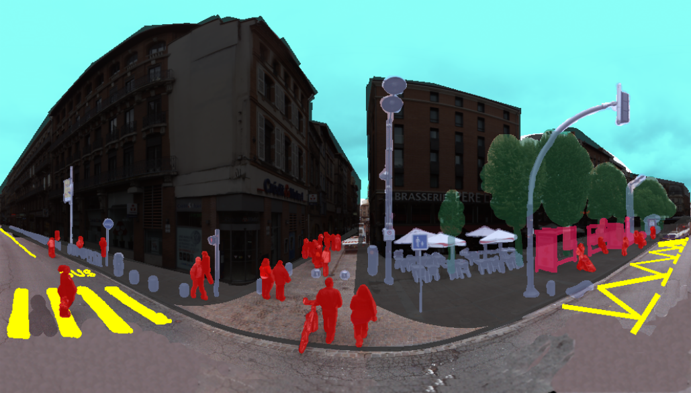
State of the art: modelling street is hard
Streets are complex

Slide 15
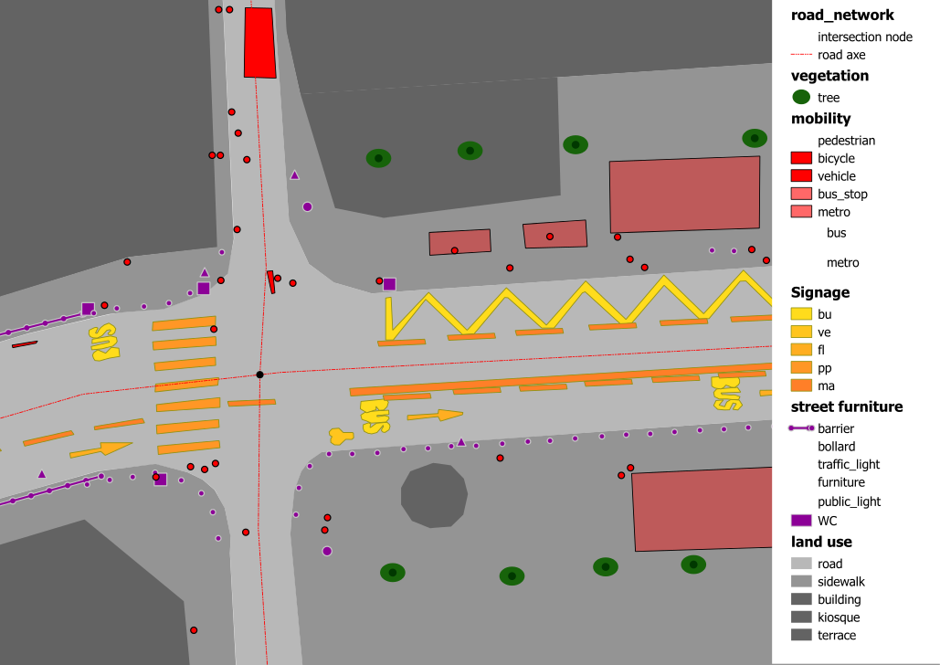
State of the art: modelling street is hard
Streets are complex

Slide 16
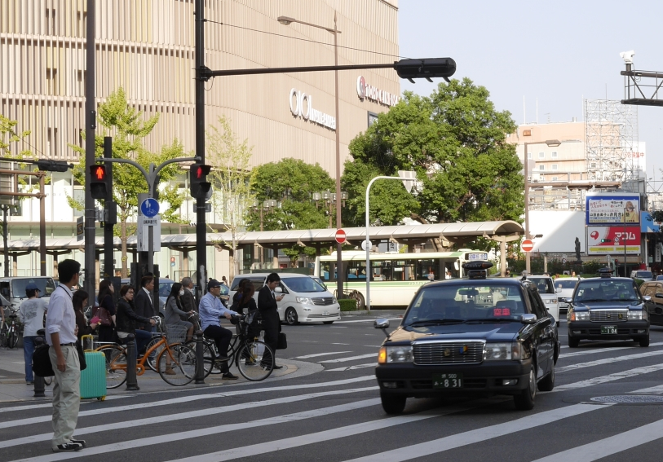
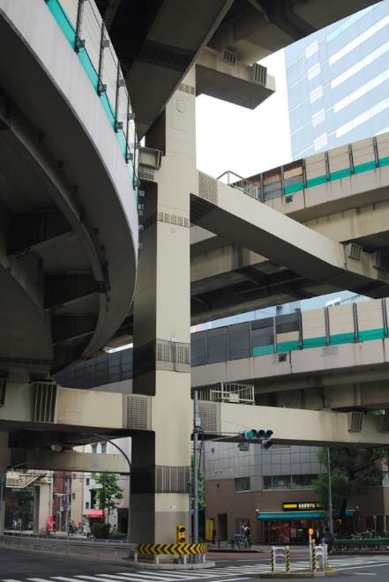
State of the art: modelling street is hard
Streets are a medium supporting all type of traffic

Slide 17
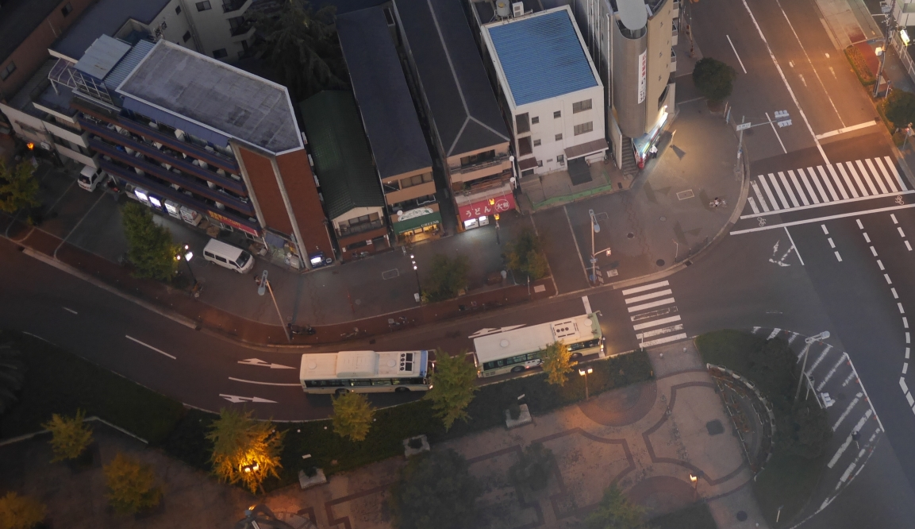
State of the art: modelling street is hard
Streets are organised (symmetry, hierarchy, part of network …)

Slide 18
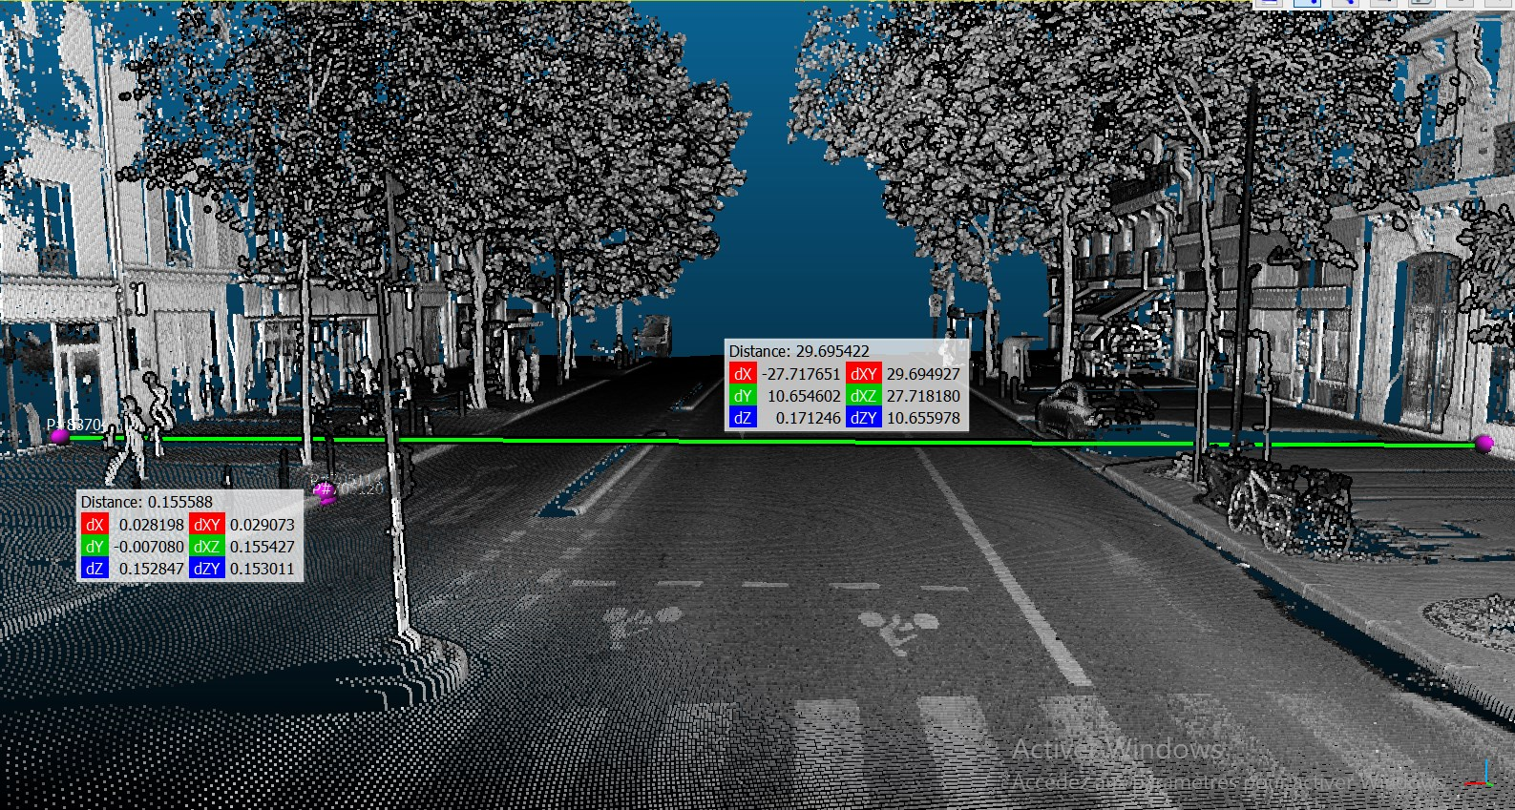
State of the art: modelling street is hard
Streets are hard to sense
Manual : millions of objects
Automatic :
high occlusion
Small details are essential (curb)

Slide 19
State of the art
Modelling street, why is it hard?
Existing models

Slide 20
State of the art: Existing models
What should be modelled?
Street precise geometry (roadway/ sidewalk / …)
Street road as part of whole network (= traffic info)
Street organisation
Street objects
Street objects relations
Material/visual aspects …

Slide 21
State of the art: Existing models
Everybody is interested by different street aspects
GIS : road as center line + buffer
Traffic simulation : road network / pedestrian space
Computer graphics : nice 3D roads blending with surroundings
Procedural city modelling : road network as start for procedural city
Remote Sensing : mostly road surface and markings
driving simulator : intersection
Automotive industrial : roadway detailed characteristics
…

Slide 22
State of the art: Existing models
Guo2015
Montoya-Zegarra2014
Boyko2011
Serna2015
Gallin2011
Wilkie2012
Chen2008
Kuntzsch2015
CityGML
Road XML
Wang2015
Open Drive
Despine2011

Slide 23
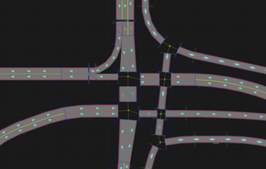
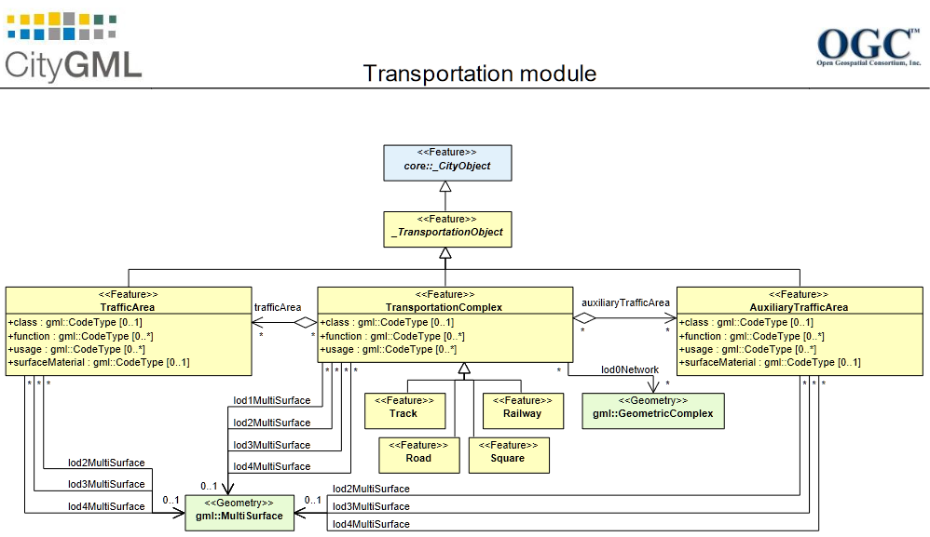
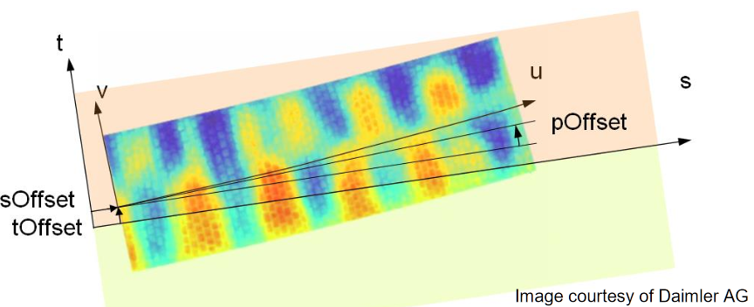
State of the art: Existing models
Whole system modelling
City GML : for city, but contains a road module
Road XML : oriented for traffic simulation
Open Drive : high geometric details

Slide 24

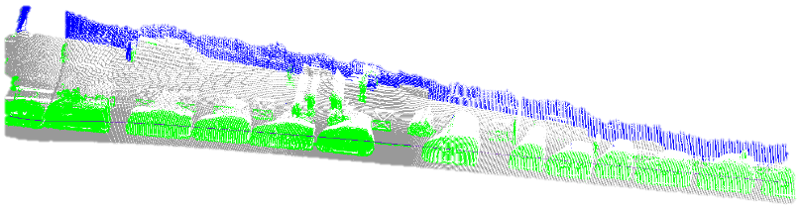
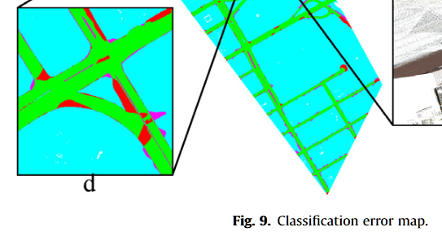
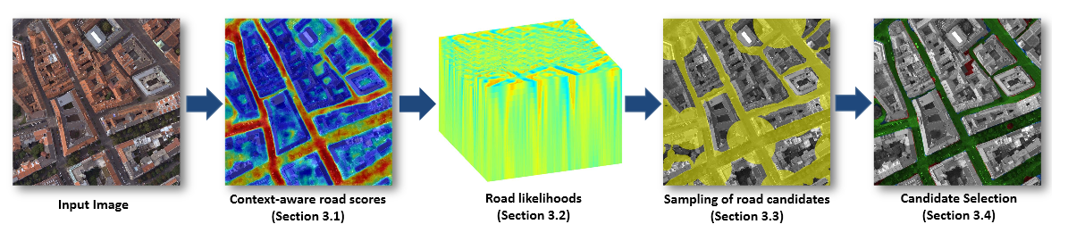
State of the art: Existing models
Data-driven modelling
From image/lidar
Guo2015
Serna2015
Cascade random forest
Extraction, raster, template matching
Boyko2011
Montoya-Zegarra2014
Fitting + active contour
Classif + Context + CRF

Slide 25
State of the art: Existing models
Data-driven modelling
From aerial imags
Todo : detailed ref for remote sensing from images

Slide 26
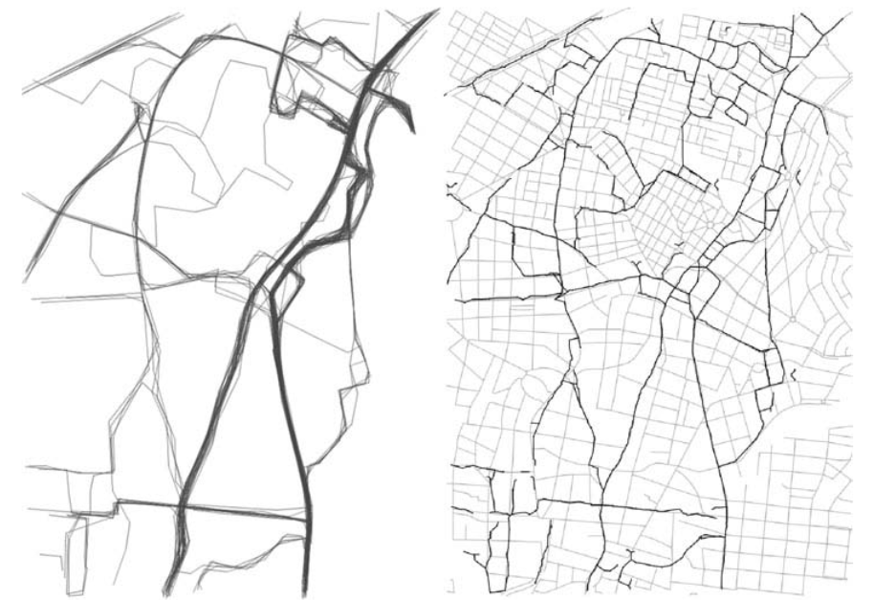
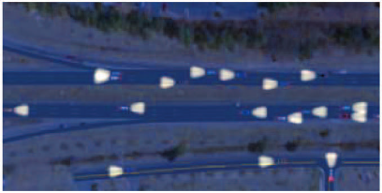
State of the art: Existing models
GIS-based modelling
Kuntzsch2015
Wilkie2012
Turning radius, network of lane, simulation
Street segment KDE, intersection with RJ-MCMC

Slide 27
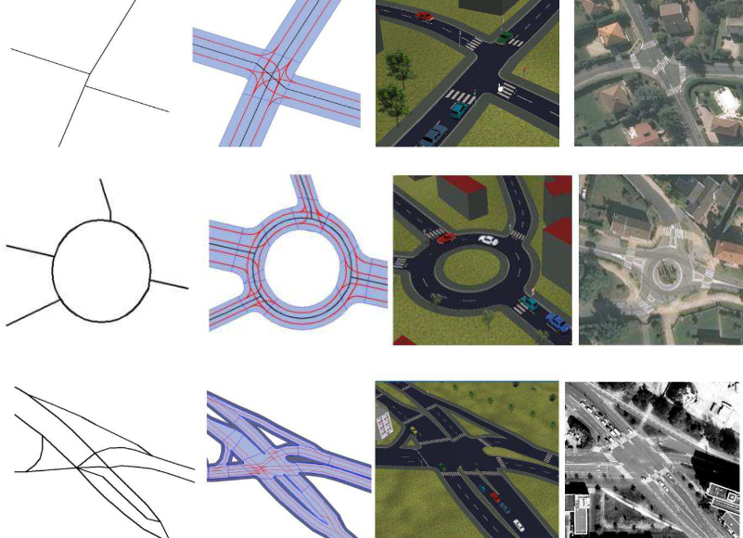
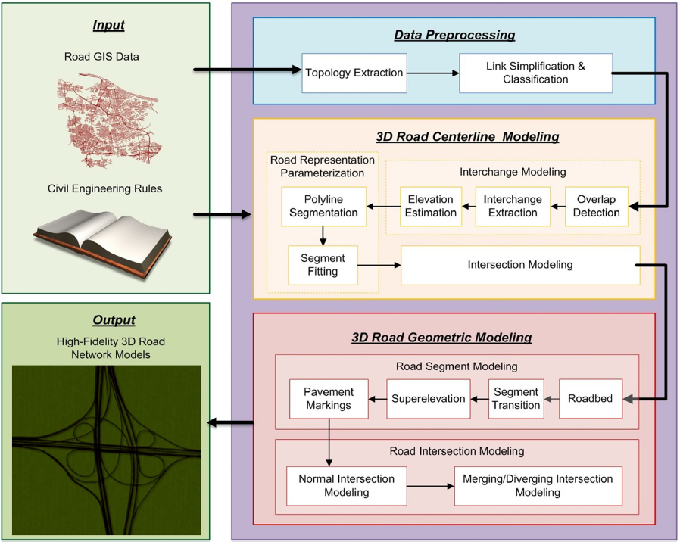
State of the art: Existing models
Simulation-based modelling
Despine2011
Wang2015
Segment of road parametrisation, intersection…
Network from data, guessing lane, intersection by continuity, 3D generation

Slide 28
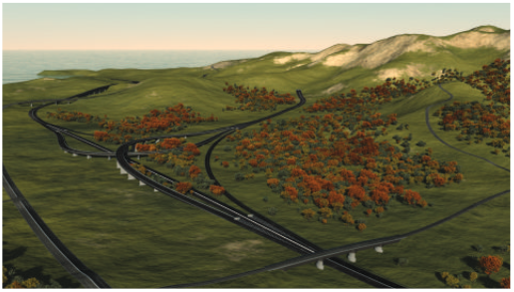
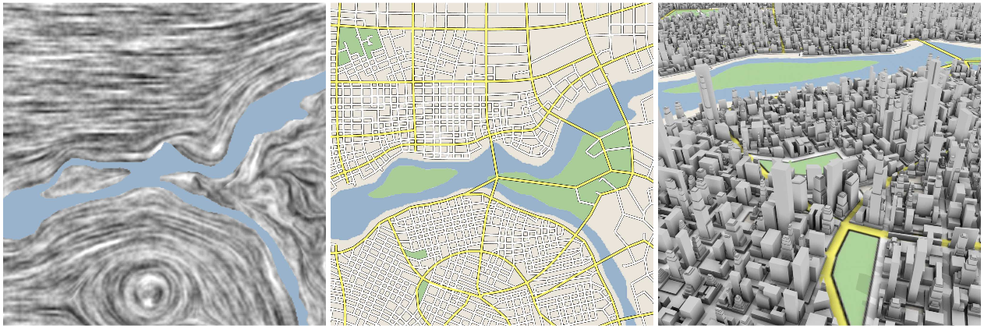
State of the art: Existing models
Procedural modelling
Gallin2011
Chen2008
Terrain, graph : shortest path and merging, procedural generation
Tensor, stream line, grammar

Slide 29
StreetGen : generate streets
Design Principle
Kinematic hypothesis
Road surface
Traffic support
Street objects

Slide 30
StreetGen : design principle
To Design = to compromise
Goals?
Model streets of whole Paris (scale, robustness)
Work with limited GIS data (best guess)
Model used for various outputs (analysis/ 3D visu / traffic simulation...)
Multi-user editing
Our approach:
Limited data : based on road axis, use simple kinematic hypothesis
Scaling & multi-user : use a RDBMS
Coherent structured model : use a RDBMS

Slide 31
StreetGen : design principle
Not a model for all streets, but a model for most of streets
3 observations on streets
Structured by street axis
2 type of parts : morphologically constant or variying
Adapted to vehicle traffic
Kinematic hypothesis :
Allows to rough out a road model
Scaling/multi-user/GIS data → use a RDBMS

Slide 32
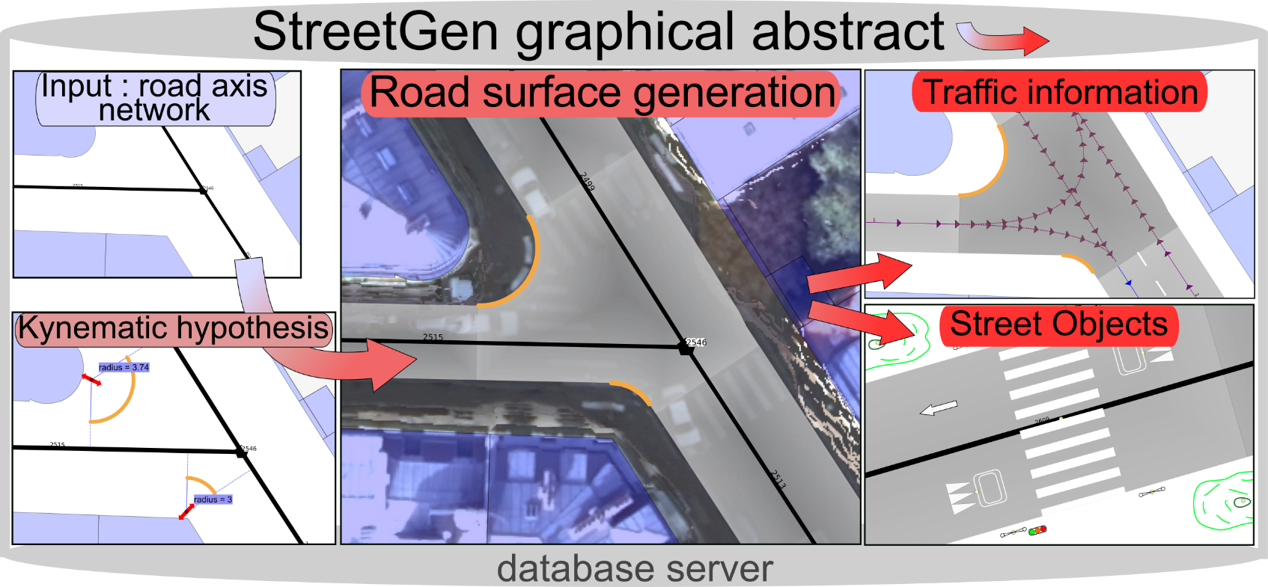
StreetGen : generate streets
StreetGen : graphical abstract

Slide 33
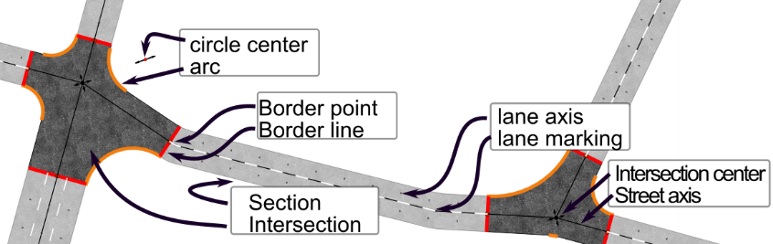
StreetGen : design principle
StreetGen road model

Slide 34
StreetGen : design principle
How to deal with several users? Use a RDBMS !
Read file , process, write results in a file
RDBMS : made to abstract & secure data
UPDATE MODELING (SYNC)
Ask computing on/ edit
Input data
User input
user
user
user
user
user
StreetGen
Road modeling
Visualize

Slide 35
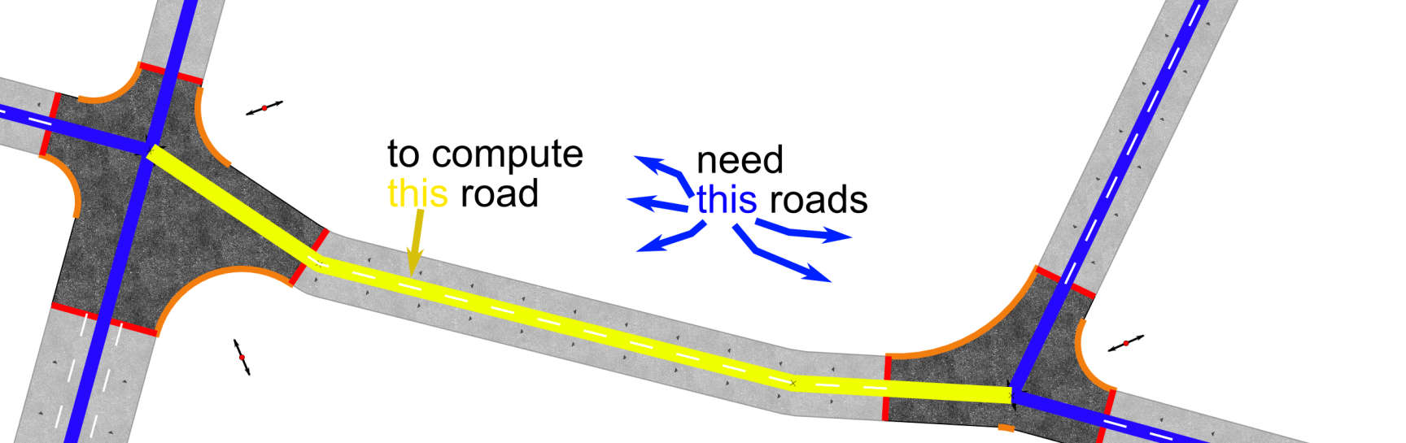
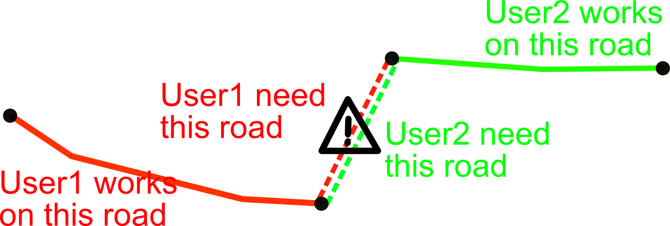
StreetGen : design principle
Need 1-neighboorhood to compute a street
May be computed simultaneously

Slide 36
StreetGen : generate streets
Design Principle
Kinematic hypothesis
Road surface
Traffic support
Street objects

Slide 37
StreetGen : Kinematic hypothesis
Hypothesis
road border is defined by a vehicle driving along it at a given speed, while making comfortable turns.
Street type → vehicle speed
Vehicle speed → turning radius
Turning radius → road surface

Slide 38
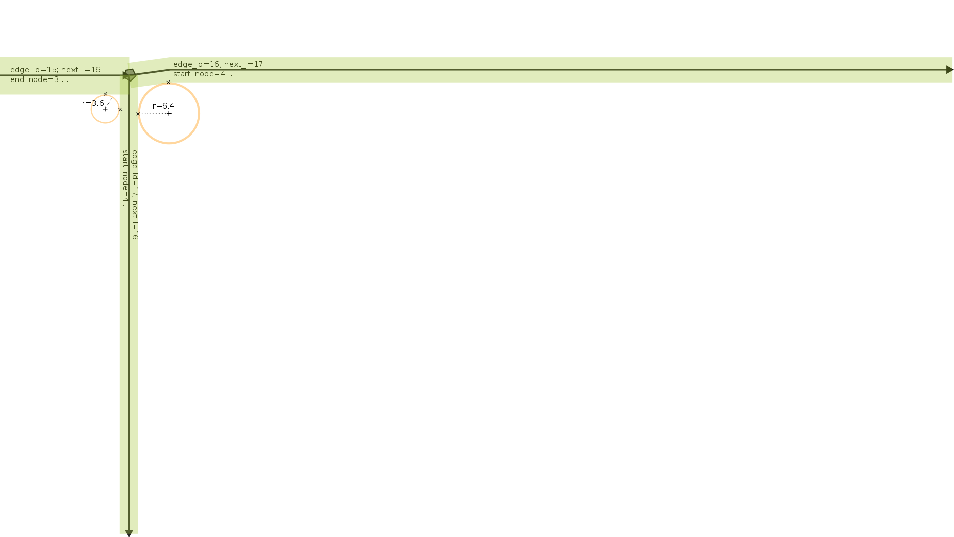


StreetGen : Kinematic hypothesis
Illustrations :
width
~ Road type
→
~ speed
→
~ radius
3m
9m
Or some actual speed database

Slide 39
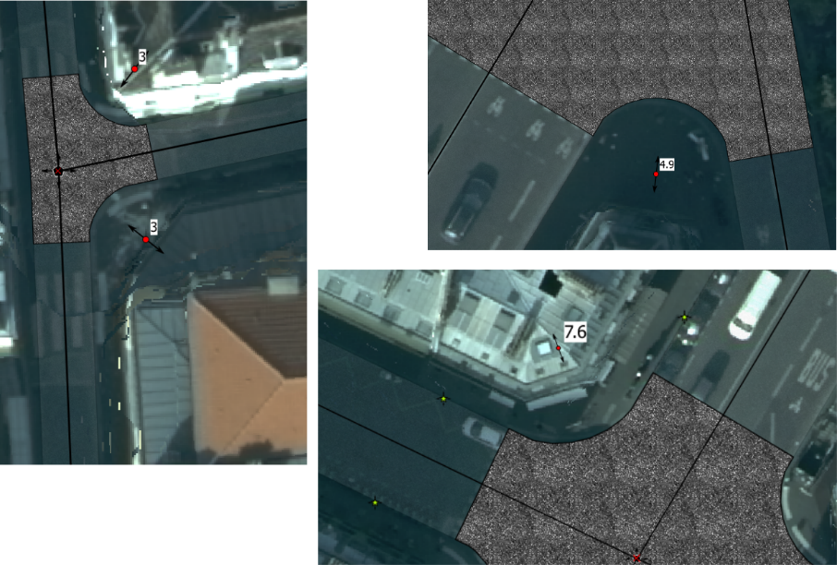
StreetGen : Kinematic hypothesis
Various radius in Paris

Slide 40
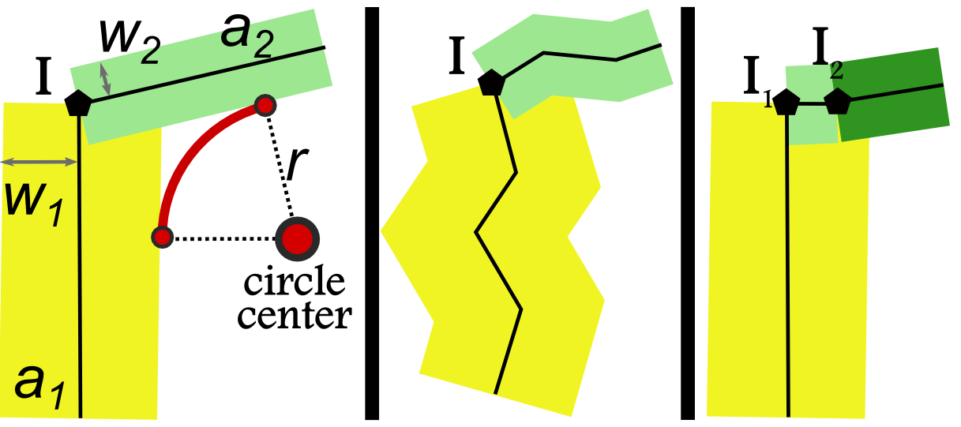
StreetGen : Kinematic hypothesis
We have road axis, road width
How to compute circle center and arcs?
analytical computing (vector, angle) ?

Slide 41
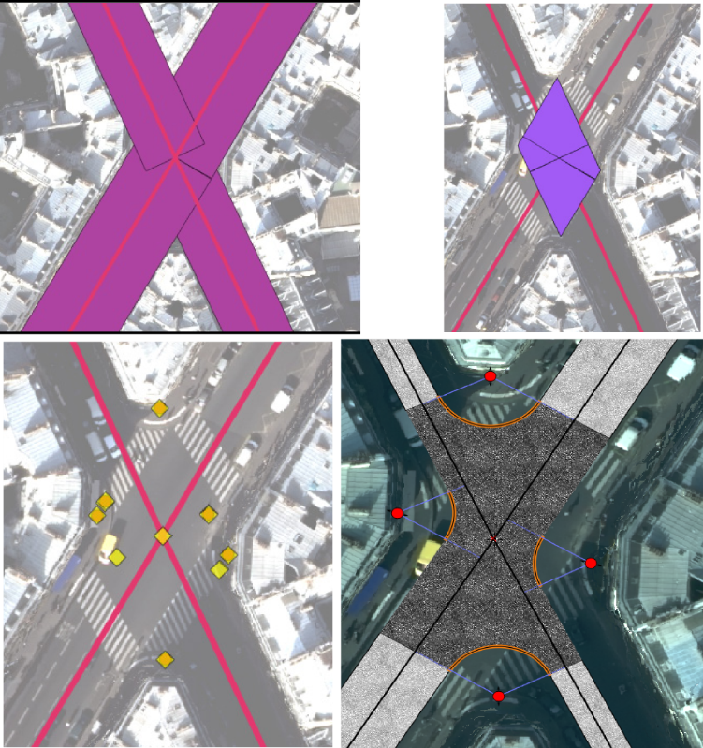
StreetGen : Kinematic hypothesis
t

Slide 42
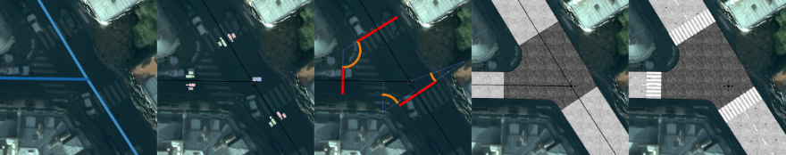
StreetGen : generate streets
Design Principle
Kinematic hypothesis
Road surface
Traffic support
Street objects

Slide 43
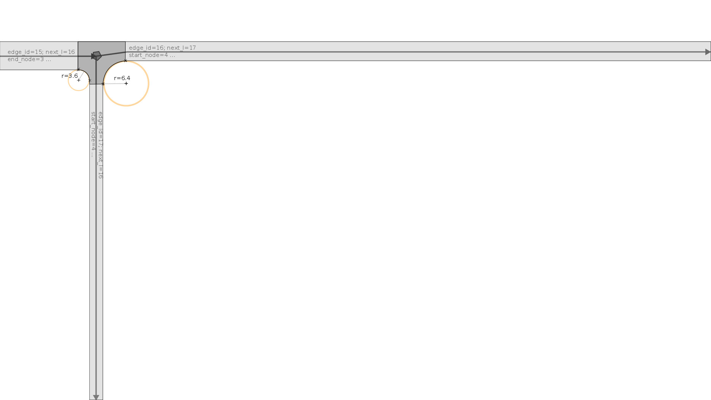
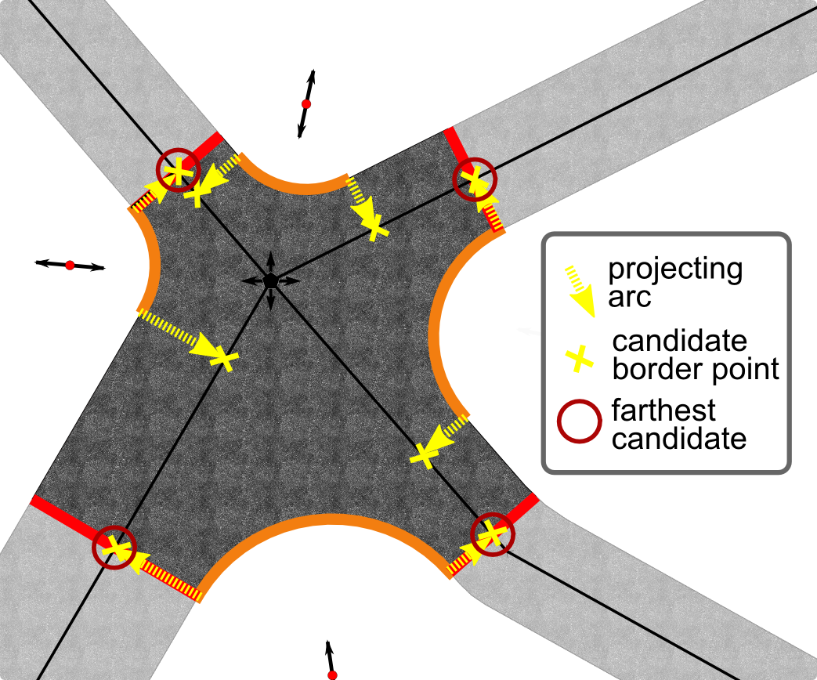
StreetGen : Road surface
4
1
Find intersection limit :
Project circle centers
Farthest per axis
2,3
1
5

Slide 44
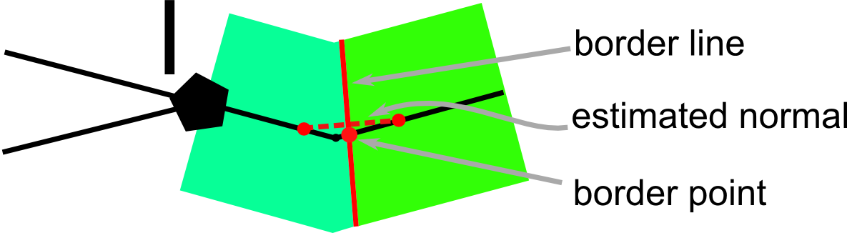
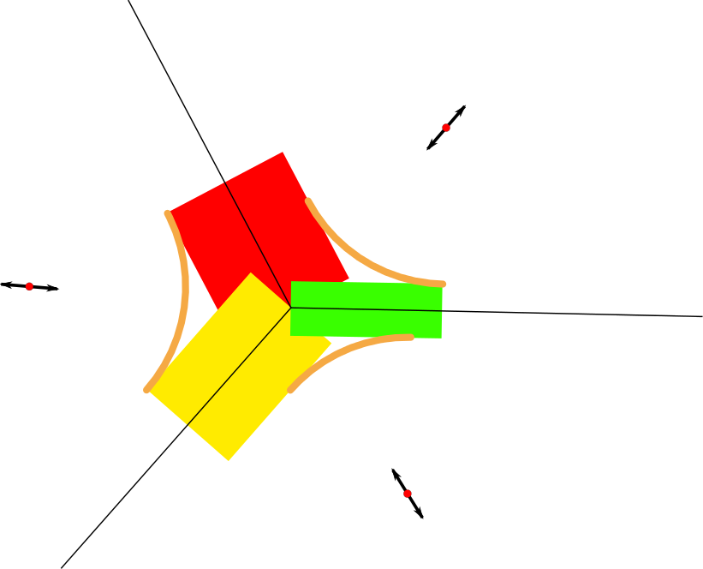
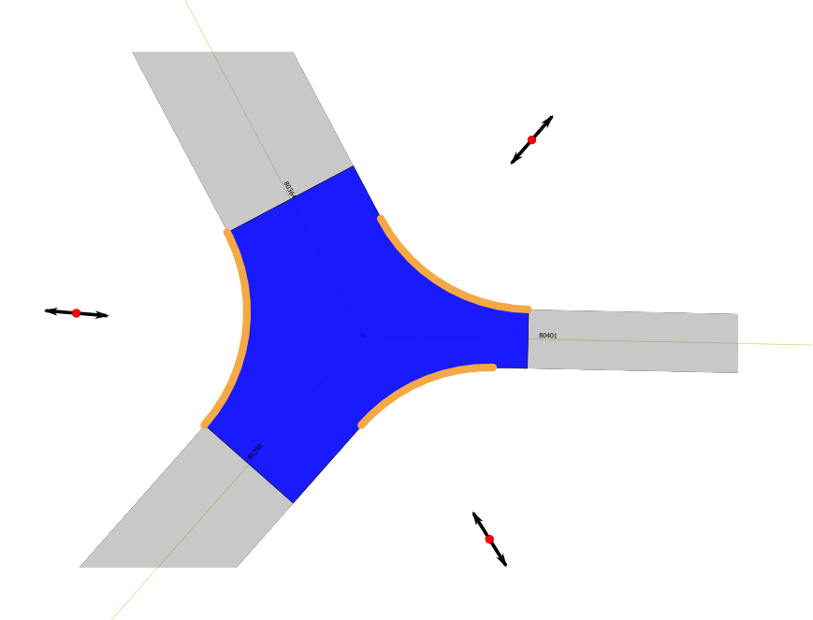
StreetGen : Road surface
Intersection surface :
By geometric operation

Slide 45
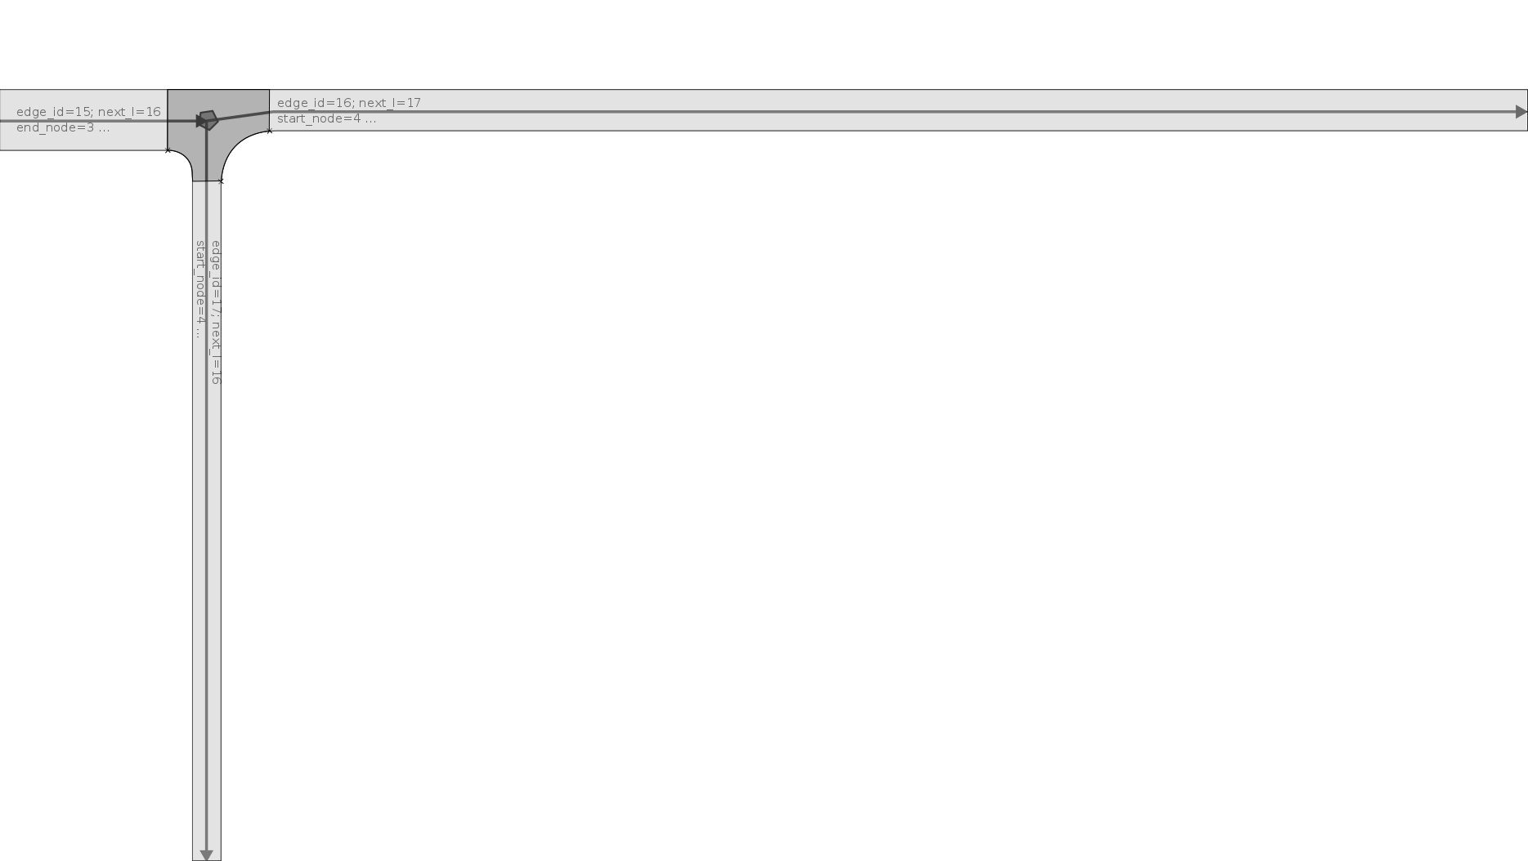
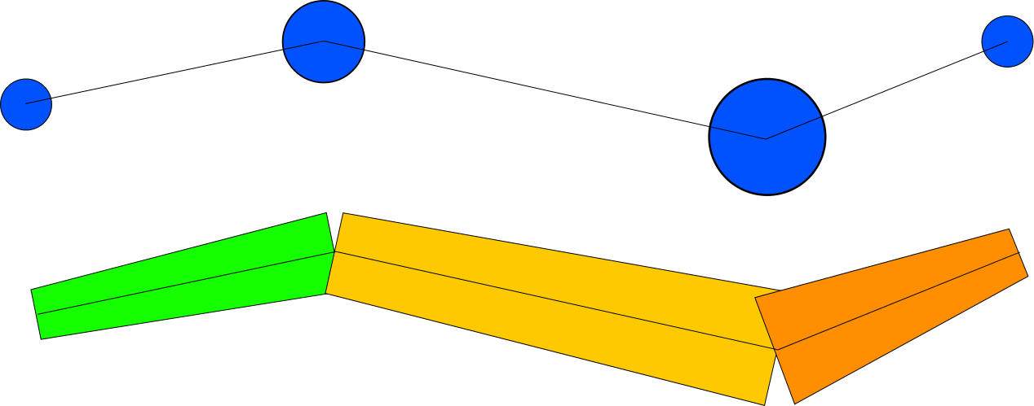
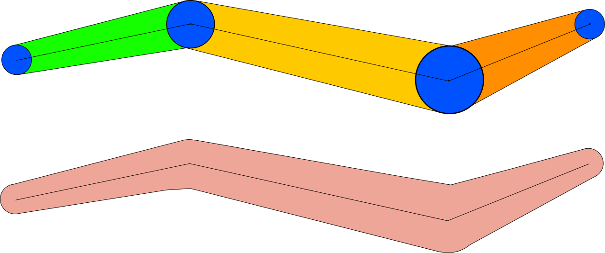
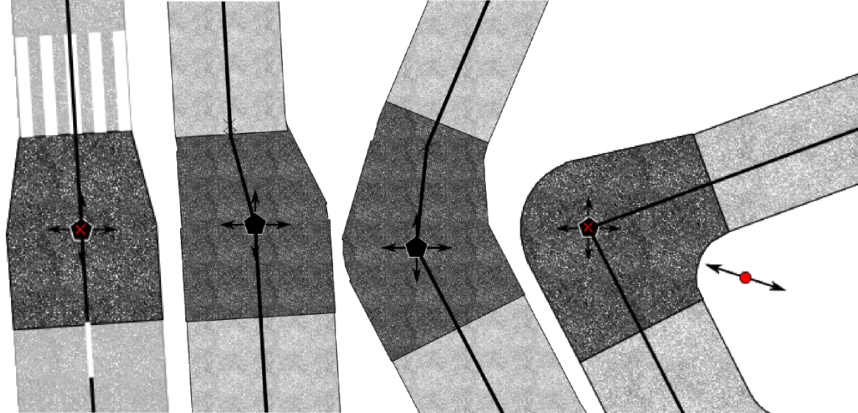
StreetGen : Road surface
Special intersection:
Variable buffer

Slide 46
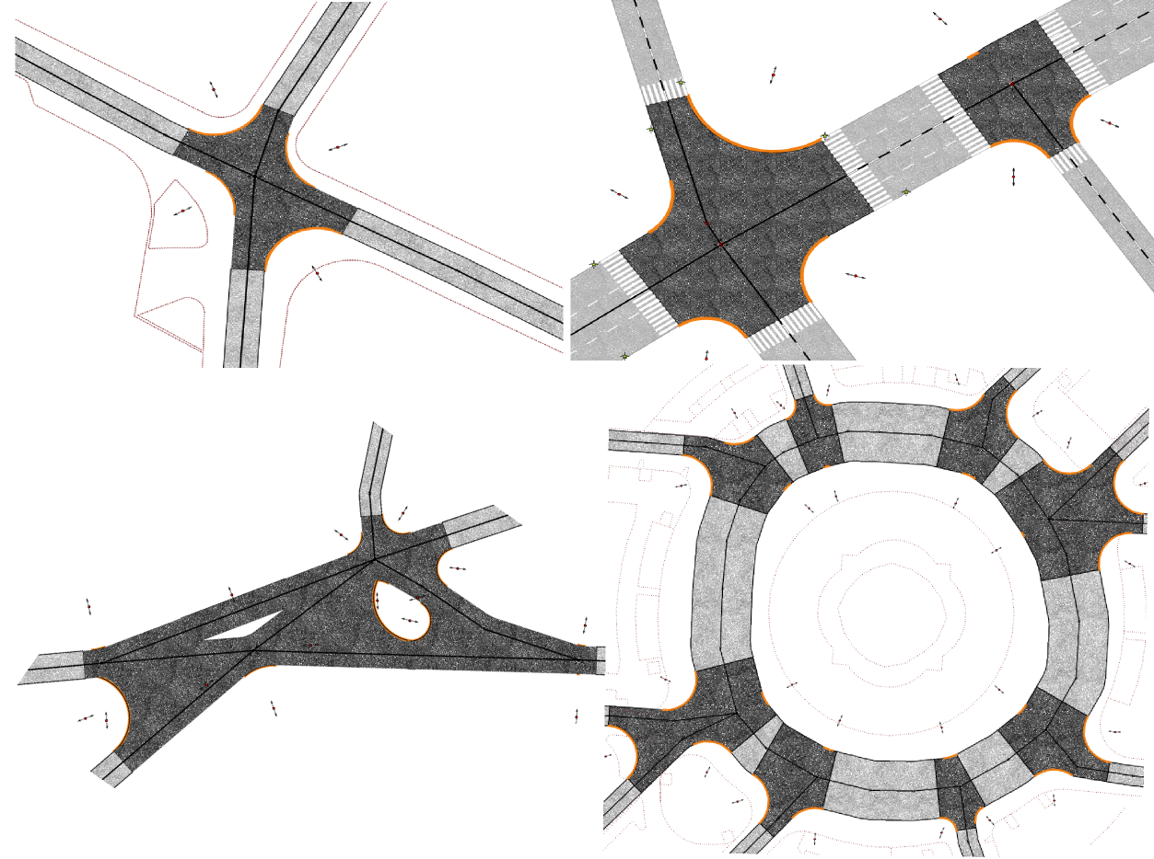
StreetGen : Road surface
results

Slide 47
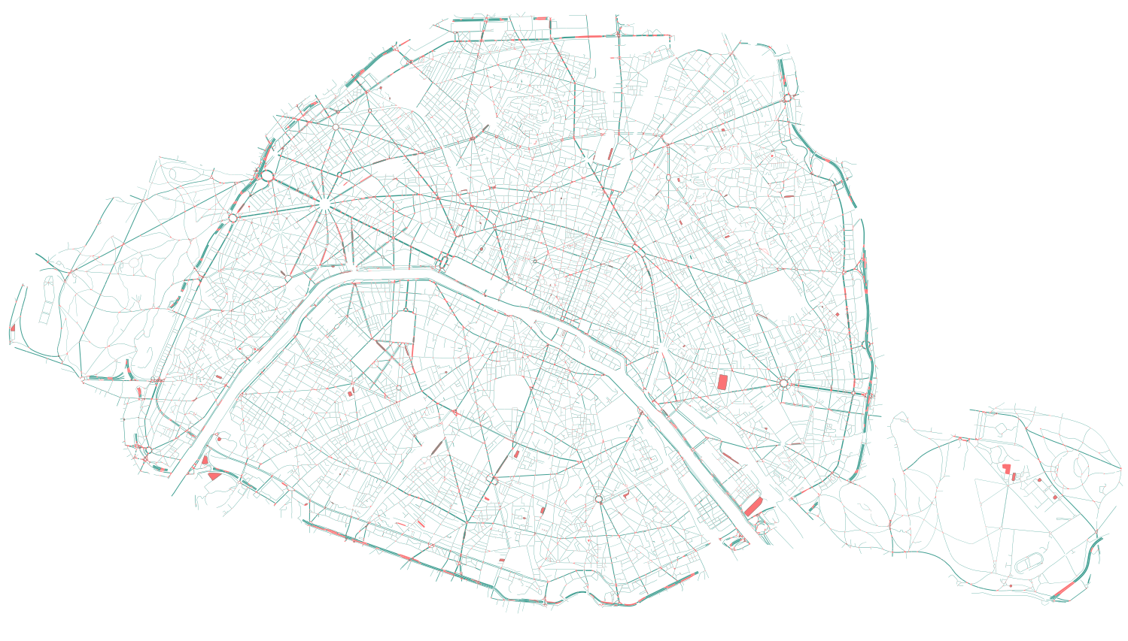
StreetGen : Road surface
Results whole Paris
Todo : merge this slide with previous by putting small zoom balloons

Slide 48
StreetGen : generate streets
Design Principle
Kinematic hypothesis
Road surface
Traffic support
Street objects

Slide 49
StreetGen : Traffic Support
For traffic simulation:
Lanes
Possible trajectories in interconnections.
A real traffic simulation requires much more
Average speed
Type of intersection (roundabout/traffic light)
Etc …
But : without further information, we do what we can!

Slide 50
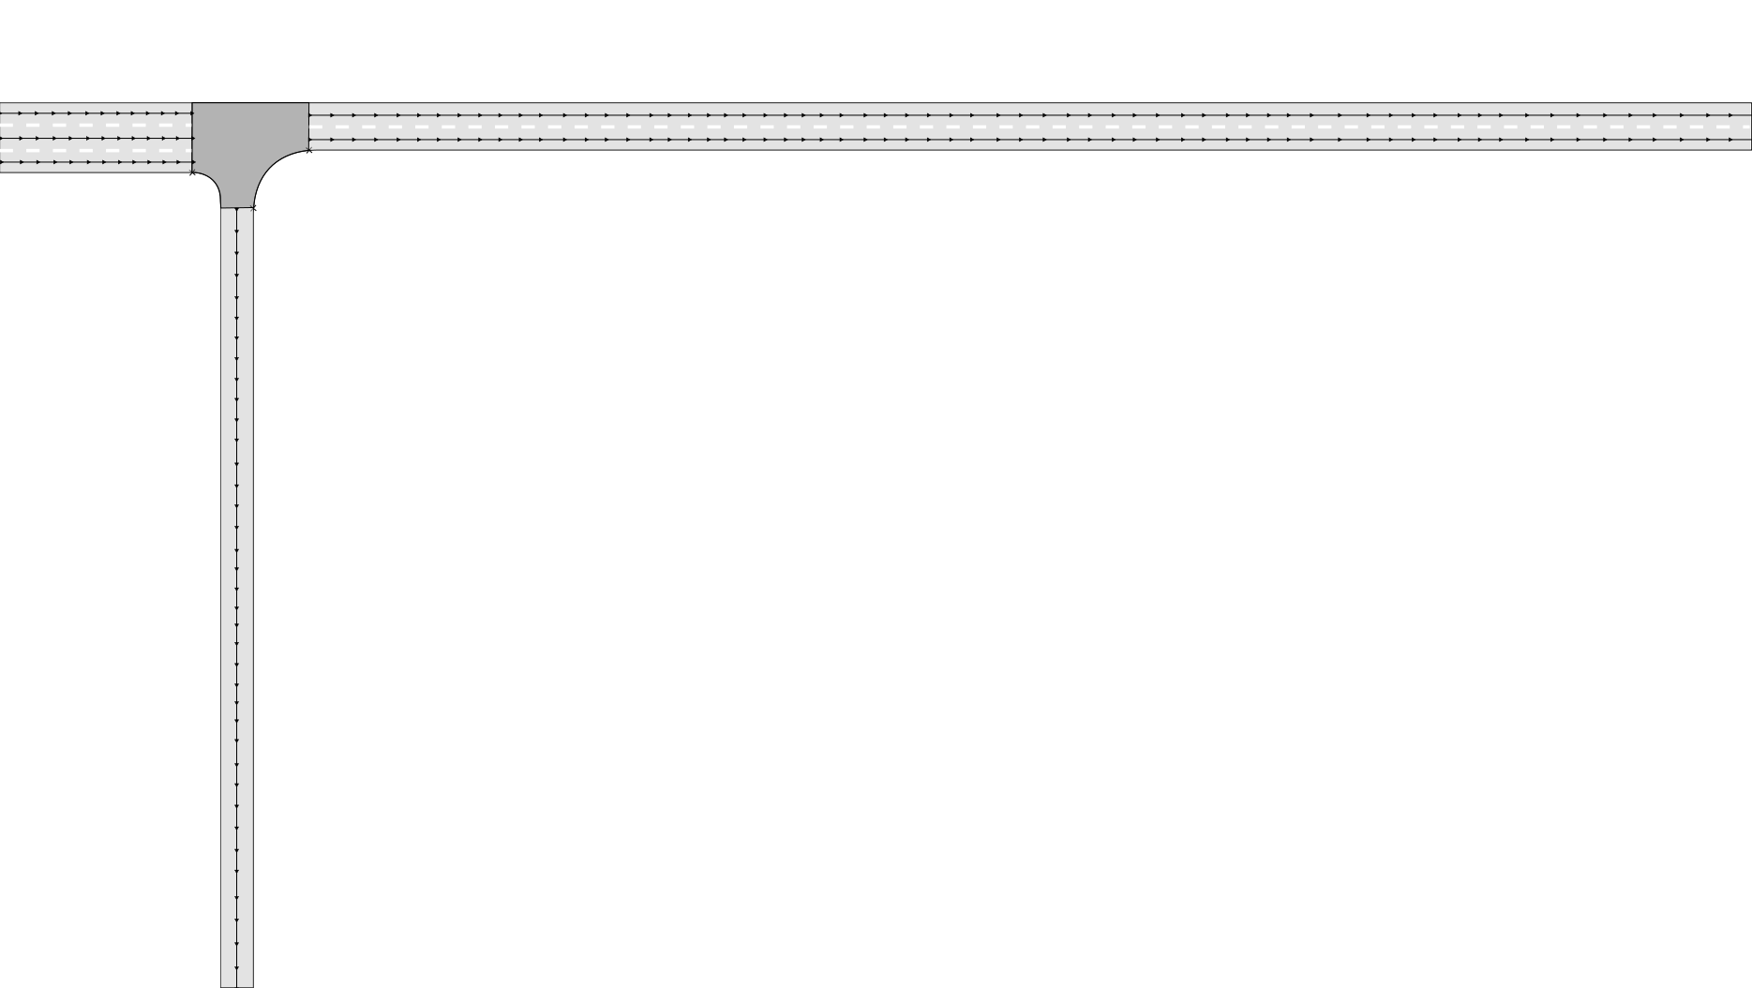
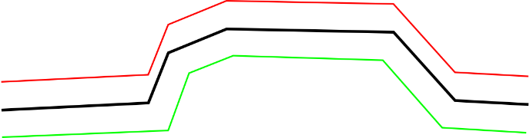
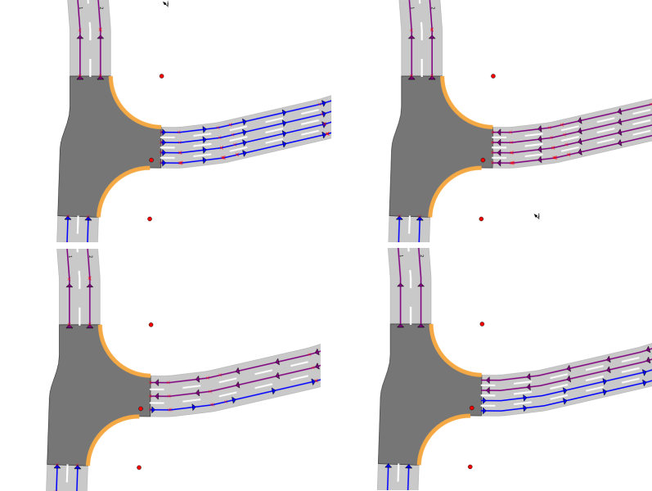
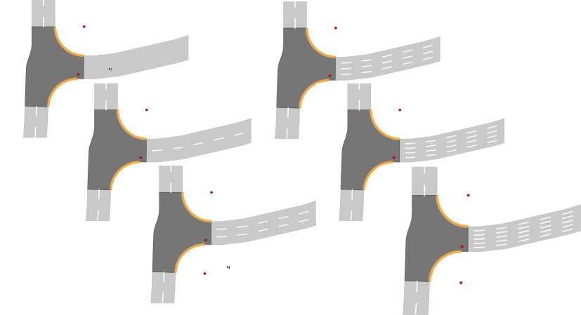
StreetGen : Traffic Support
Lane based on road axis : but not translation

Slide 51
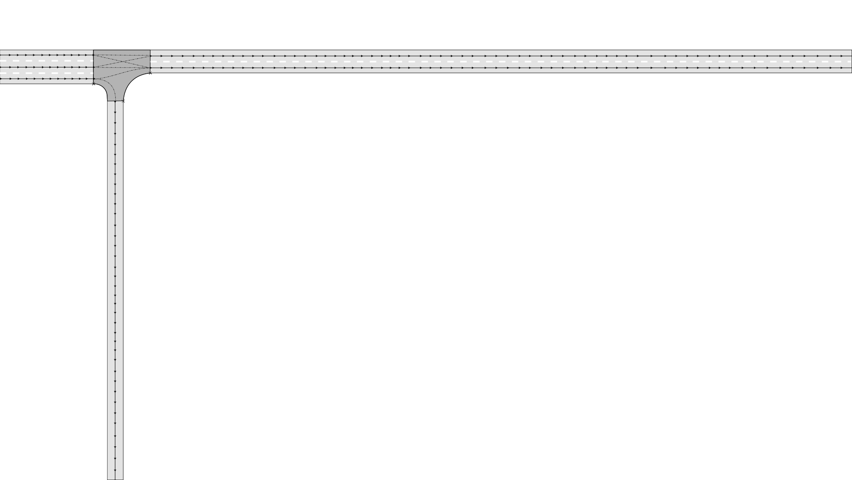
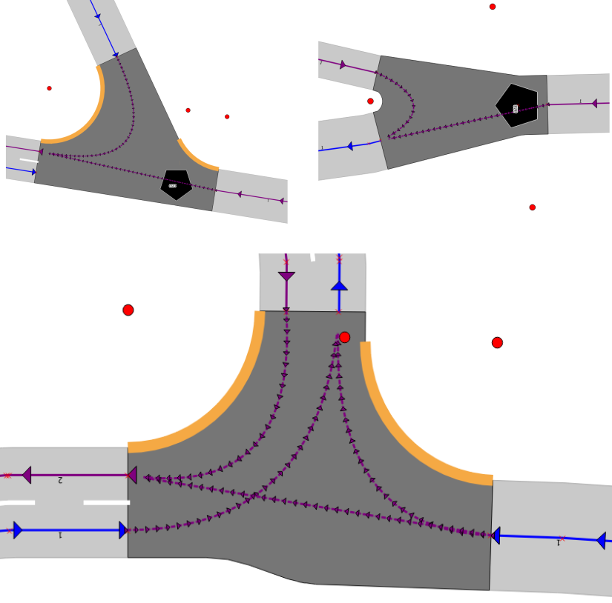
StreetGen : Traffic Support
Intersection trajectory : Bezier curves:
Not accurate (cinematically), but easy to create and edit
Involves center of intersection in special cases

Slide 52
StreetGen : generate streets
Design Principle
Kinematic hypothesis
Road surface
Traffic support
Street objects

Slide 53
StreetGen : street objects
Streets objects : incredibly varied
13k references on ArchiExpo
Markings : 1k pages of norms
…
Objects are in relation (hierarchical, spatial, semantic …)
Not many common points between all kind of street objects
Street objects are often spatially organized relatively to the street axis

Slide 54
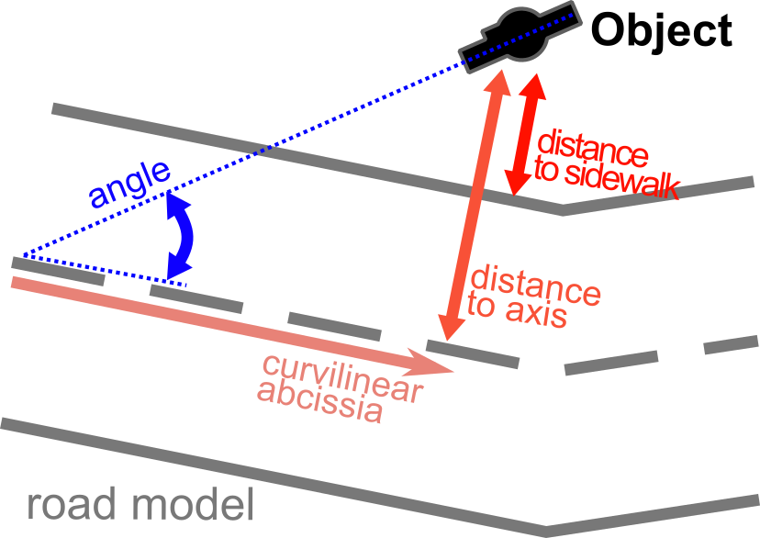
StreetGen : street objects
So we use generic objects
Positioned/oriented relatively to street axis

Slide 55
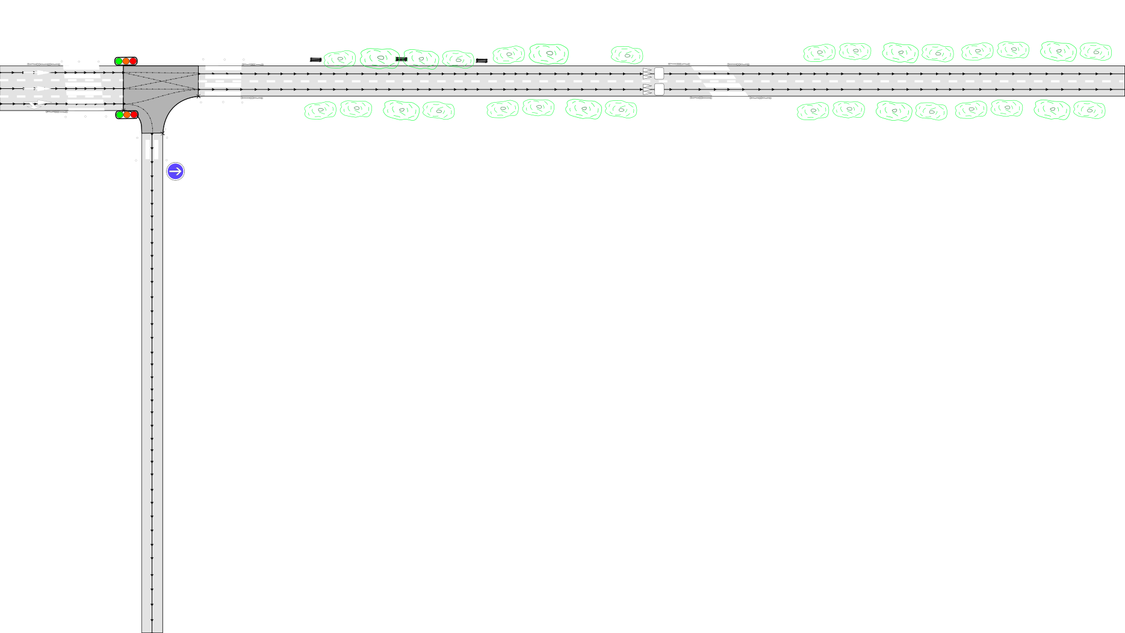
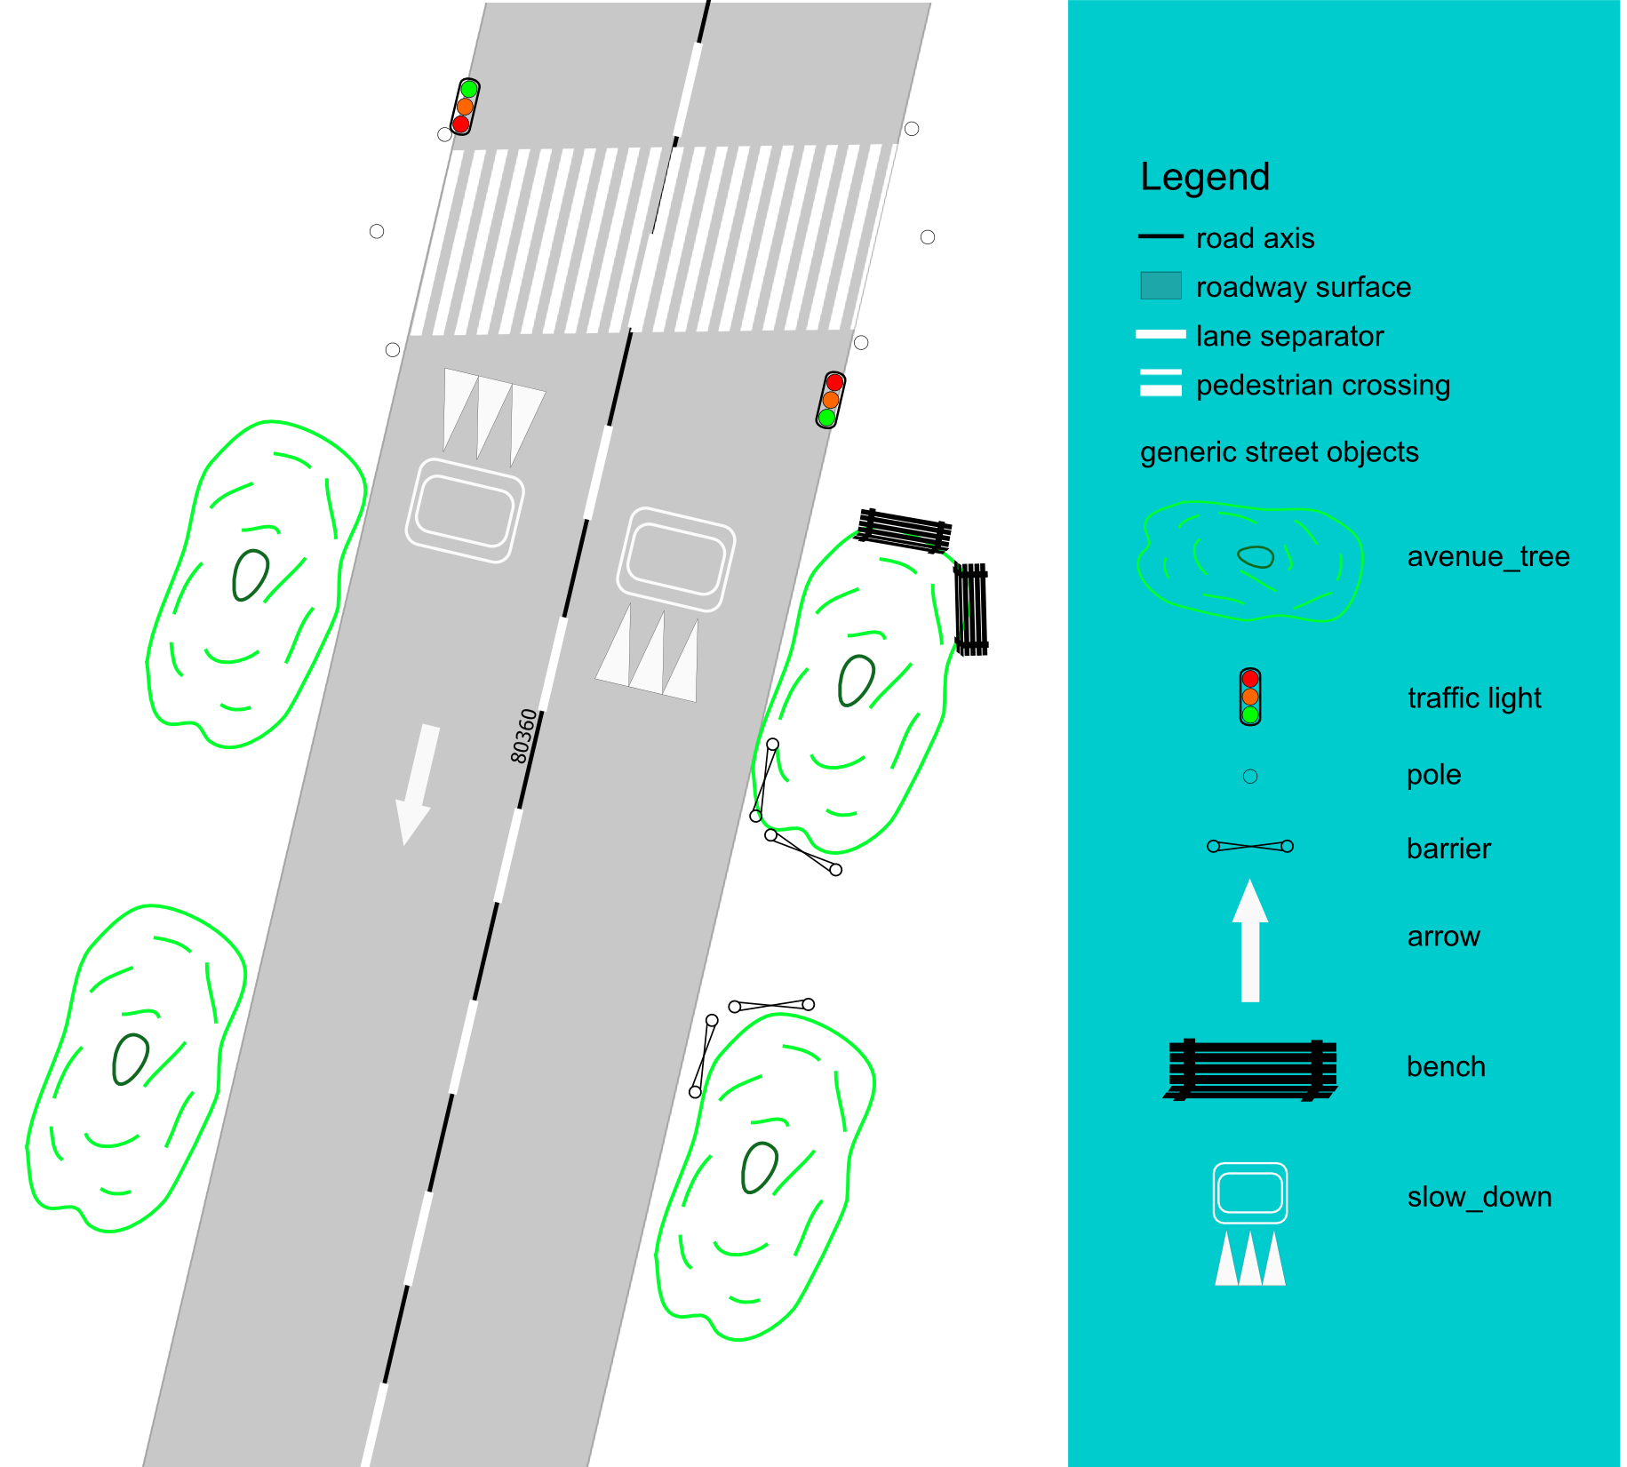
StreetGen : street objects
Objects are points with semantic
DBMS can support any relation (hierarchy, semantic…)

Slide 56
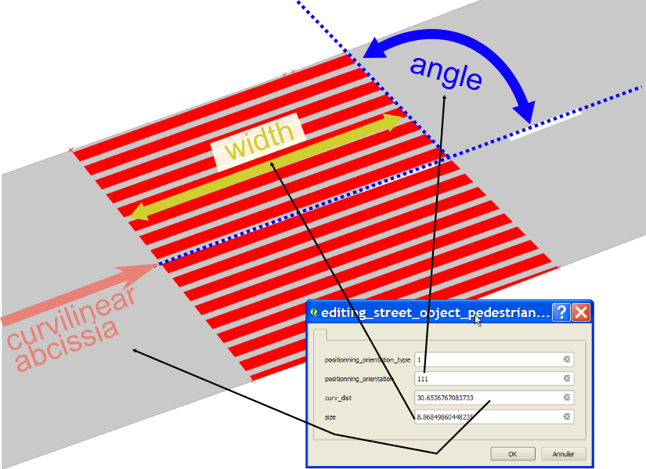
StreetGen : street objects
Also can also be surface (or polylines?) :
Pedestrian crossing for instance

Slide 57

StreetGen : street objects
Whole Paris in 10 min.
Tested for simulation (SimuVia)
Tested for 3D visu (Thales NeoDBGS)
Tested to model other cities (West Africa)
Tested to model airport runway

Slide 58
StreetGen : street objects
Of course, lot of limitations
Street model:
Not enough for some street
Radius seems to be historical rather than related to speed
Technical
Technical glitches/bugs
Precision issues
Traffic
All possible interconnection : too much
Objects
Lack linear objects

Slide 59
StreetGen : editing streets (in-base)
In-base interaction Principle
Edit road model
Edit traffic
Edit objects

Slide 60

StreetGen : street objects
How to edit street model easily (several concurrent users) ?

Slide 61

StreetGen : street objects
Fact : developing a Graphical User Interface (GUI) is hard, long and risky (maintenance)
Many GUI for many tools (web/desktop/…)
Need to create plugins/interfaces/…
Idea : use existing tools
GIS tools can already edit vector and attributes
specific interactions are in base

Slide 62

StreetGen : street objects
example:
In GIS software
In base

Slide 63

StreetGen : street objects
In-base interaction are generic and powerful
Design pattern to help use it for other applications

Slide 64





StreetGen : street objects
All StreetGen street model can be edited concurrently
Road axis/ width
Radius
Lane
Interconnection
objects

Slide 65


StreetGen : street objects
Multi-user editing can be facilitated
“Interactive Map Tracking” QGIS plugin with Lionel Atty

Slide 66

StreetGen : street objects
Results:
Interaction are fast enough to be interactive
Video
https://youtu.be/fQZoEfUcNHA

Slide 67

StreetGen : street objects
Several Limitations
In-base interaction should be limited to straightforward interaction (guessing user action is easy)
Hard to develop/test/maintain (no modern signal feature)
All interaction happen in one transaction → should be short
Topological network editing is limited (ill-posed problem)
Initial building of topology is slow
More information needed for traffic simulation
Objects:
relative to absolute positioning is not a bijection

Slide 68
Automating street modelling
Inverse procedural modelling concept
Fitting model to real streets

Slide 69


StreetGen : Inverse procedural modelling
Fit a generic procedural model to a specific situation
Specific situation?
→ We need data!
Todo : put another work
Simon2011
Talton2011

Slide 70
Abstract
Procedural Street Modelling

Slide 71
Abstract
Inverse
Procedural Street Modelling

Slide 72

StreetGen : Inverse procedural modelling
What type of data for streets?
Precise
Good coverage
Frequent
Aerial image?
Good coverage
Low 3D precision

Slide 73
StreetGen : Inverse procedural modelling
IGN dedicated mobile mapping: Stereopolis
Cameras
Lidar

Slide 74

StreetGen : Inverse procedural modelling
Street view:
Good coverage

Slide 75

StreetGen : Inverse procedural modelling
Lidar: 3D point clouds
precise 3D

Slide 76

Automating street modelling
Inverse procedural modelling concept
Fitting model to real streets

Slide 77

Inverse Procedural modelling: method
Initial road model + observation → optimisation → fit road model

Slide 78

Inverse Procedural modelling: method
Initial road model + observation → match observation to axis optimisation → fit road model

Slide 79


Inverse Procedural modelling: observations
Observation = clues about roadway

Slide 80

Inverse Procedural modelling: observations
Observation = clues about roadway

Slide 81


Inverse Procedural modelling: forces
Observations generate forces on road axis/width
Each street object type has an expected position:
IN/OUT + BORDER_IN/BORDER_OUT (dist)
Ex :
road markings : IN
Pedestrian crossing marking : BORDER_IN (0.2 m)
Traffic sign : OUT
No parking markings : BORDER_OUT (0.1m)

Slide 82

Inverse Procedural modelling: forces
Each type of street object expected position is defined in a table

Slide 83

Inverse Procedural modelling: forces
Observations generate forces on road axis/width
Each street object type has an expected position:
IN/OUT + BORDER_IN/BORDER_OUT + dist

Slide 84

Inverse Procedural modelling: forces
So if we sum up forces from observations :

Slide 85

Inverse Procedural modelling: forces
Others forces: resisting changes : express confidence in initial road model

Slide 86


Inverse Procedural modelling : matching
Observations generate force on road axis/width, But first :
Observation ←matching→ road axis:
Closest road surface

Slide 87

Inverse Procedural modelling: matching
In intersection : can’t use observations:
We would need to optimise full road surface model
Todo : add illustration of what would happen if these obs were taken into account

Slide 88

Inverse Procedural modelling: experiment
Optimisation = Non-linear least square
→ no guarantee to find the optimal solution, robust, very fast
Open source : Ceres solver
Areas of experiment:

Slide 89


Inverse Procedural modelling : small area

Slide 90

Inverse Procedural modelling : small area

Slide 91

Inverse Procedural modelling : small area

Slide 92


Inverse Procedural modelling : small area

Slide 93


Inverse Procedural modelling : small area

Slide 94
Inverse Procedural modelling : small area
Quantitative evaluation:
Only kerb observation:
Median dist to sidewalk : from 1.8m → 0.4m
Kerb observation + user input
Median dist to sidewalk : from 1.8m → 0.34m
It’s much better in a challenging area!
Todo : simplify

Slide 95

Inverse Procedural modelling : sensing area
Whole sensing area:
Results:

Slide 96

Inverse Procedural modelling : sensing area
Yellow circle are proportional to error:
Most of the cases :
Not enough curb detection!
Sometime:
Road model not sufficient
Seldom:
Optimisation not optimal
Todo : simplify

Slide 97
Inverse Procedural modelling : sensing area
Quantitative evaluation:
Only kerb observation:
Median dist to sidewalk : from 1.5m → 0.6m
Many streets in the area lack kerb observations, but still significantly better.
Todo : simplify

Slide 98

Inverse Procedural modelling : Paris area
Whole Paris : topology is broken at few points
Few enough to manually correct

Slide 99
Inverse Procedural modelling: Paris area
Quantitative evaluation:
Using ground truth as observation
Median dist to sidewalk : from 1.5m → 0.1m
still residuals, why?
Todo : simplify

Slide 100

Inverse Procedural modelling: error sources
Residual sources

Slide 101
Inverse Procedural modelling: Streetgen on optim
Once simple road model is optimised, we can generate streets with StreetGen

Slide 102

Inverse Procedural modelling: Streetgen on optim
Streetgen after optimisation

Slide 103

Inverse Procedural modelling: Streetgen on optim
Traffic information is generated (but has not been optimised)

Slide 104
Inverse Procedural modelling: Limitations
(Many) Limitations
Road model is too simple
Constant number of parameters in optim
For the moment, objects are almost useless
Lacking regularisation forces for width (propagation)
Must choose between trusting initial model and trusting observations
How to deal with parking places?

Slide 105
Data for observations: Point Cloud Server
Short introduction to Lidar
Point Cloud Server

Slide 106

StreetGen : Inverse procedural modelling
Demo Live mobile mapping Lidar (Velodyne)

Slide 107
Data for observations: Point Cloud Server
Short introduction to Lidar
Point Cloud Server

Slide 108



Point Cloud Server
Point Cloud Server : manage massive amounts of geospatial point clouds in a database.
Many type of geospatial point clouds
Terrestrial LIDAR
Medical
imaging
Aerial LIDAR
Stereovision

Slide 109
Point Cloud Server: Problems
Problem:
Massive data → need
Sharing
Filtering
Efficient I/O
Compression
Very specific for various purposes
(many tools/formats/usage)
Point cloud != only processing
need to manage the entire pipeline
need meta data / contextual information
cross use with other data

Slide 110
Point Cloud Server: State of the art
Otepka et al., 2013
File-based
Simple, no concurrency
Can’t do much with points
DBMS (point storing)
Powerfull
Can’t scale
NoSQL
Scale well
Specific and tailored
Cloud
Ultimate scaling
Theoretical problem with indexing
DBMS (group of points storing)
All inclusive
Points need to be group-able
Rieg et al., 2014
van Oosterom et al., 2015
Todo : simplify, images
Managing billions of nD-points : difficult !
Greyhound
≠
Managing millions of groups of points: easy!

Slide 111






Point Cloud Server: Method
Idea:
PCS = a … server !
Point Cloud Server
File system
Many interfaces
possible
Abstraction
safe
RDBMS

Slide 112

Point Cloud Server: Method
Workflow

Slide 113



Point Cloud Server: Method
Main idea about storing
1 point =
GPS_time (s) X (m) Y(m) Z(m) reflectance (…. )
54160.295 2068.230 20690.025 45.934 -9.4497 (…. )
1 row = 1 point
Analogy : Pixels
1 row = N points
Analogy : Image
Color = group
Billions points
Million groups
Usage : do we really need to get points 1 by 1?

Slide 114


Point Cloud Server: Loading/Exporting
Loading/exporting points into the PCS:
2 flavors : how much does the server work?

Slide 115


Point Cloud Server: Loading/Exporting
Paris
Terrestrial lidar
2.15 B points
750 ply files
42 linear km
21 attributes
Typical resolution: 1 cm

Slide 116

Point Cloud Server: Loading/Exporting
Paris loading speed: 75k pts/s writing : 200k pts/s
Not far from actual sensing speed
Could be faster (Vanoosterom2015)
We load point clouds, but how are they stored?

Slide 117

Point Cloud Server: generalisation
Group of points (aka patch) generalisation
Generalisation = abstraction

Slide 118
Point Cloud Server: generalisation
Other generalisation
Essential : abstracting the data = more abstract usage
Ex : points within flat neighborhood vertical VS points in a wall
Top view in QGIS

Slide 119


Point Cloud Server: processing
More generalisation

Slide 120

Point Cloud Server: filtering
With so much data:
Essential to access only a part of it : example
Patches that are
far from buildings
close to the intersection these 2 streets
aerial view color ≈ pedestrian crossing
close trajectory
with high point density

Slide 121






Point Cloud Server: filtering
Result : finding millions of points amongst billions :
100 ms if indexed !
Which points are inside the polygon?
Which patchs are inside the polygon?
Get points in these patches
Which points are inside the polygon?
points
Points in patch
?

Slide 122



Point Cloud Server: processing
Postgresql: easy to add in-base processing
C/Cpp → for performance
R/Python → for fast prototyping
Example :
Verticality descriptor
Unsupervised clustering
Plane & cylinder detection

Slide 123










Point Cloud Server: processing
Converting patch to raster
Cornerstone detection
Marking detection
Façade detection

Slide 124

Point Cloud Server: processing
classification

Slide 125

Point Cloud Server: processing
Patches can be used in a graph structure

Slide 126

Point Cloud Server: Level Of Detail
Level Of Detail (LOD):
Sometimes you don’t need all the points
12 Millions points, really?
User needs only a given Level Of Detail.

Slide 127

Point Cloud Server: Level Of Detail
Idea : implicit LOD
order the point by importance
Reading the points gradually increases the level of detail

Slide 128






Point Cloud Server: Level Of Detail
Example

Slide 129

Point Cloud Server: Level Of Detail
For visualization, LOD depends on distance to camera

Slide 130
Point Cloud Server: Level Of Detail
LOD enables point streaming
Mettre screen paul blottiere

Slide 131

Point Cloud Server: Level Of Detail
Also for classical GIS soft that can’t deal with too many points

Slide 132

Point Cloud Server: Level Of Detail
Limitations
Points have to be group-able
Our Loading/export could be much faster
Filtering is fast at patch level(O(ln(n))), not point level (O(n))
LOD : rely on ordering the points !
You have to use it
May be slow to build
For the moment, getting a part of the patch require to read it entirely

Slide 133
Conclusion
Summary
Limitations
Perspectives

Slide 134
Conclusion: Summary
From low information: generate best guess street model at Paris scale and edit it (multi-user, using many GIS software): StreetGen

Slide 135
Conclusion: Summary
Manage a massive amount of 3D points (from mobile mapping). Act as a service for usage/processing/visu: Point Cloud Server

Slide 136
Conclusion: Summary
Perform inverse procedural modelling by fitting a road model to various observations

Slide 137
Conclusion
Summary
Limitations
Perspectives

Slide 138
Conclusion: Limitations
Very simple street model: revolves around street axis.
Too simple?
Pedestrian street?
Based on topology → hard to maintain/scale/edit
Point Cloud Server :
Need several processing methods to extract observations
Coupling with street images missing
3D from images? Updating?
Objects are created/edited manually by user
Tedious, not much sense

Slide 139
Conclusion
Summary
Limitations
Perspectives

Slide 140
Conclusion: Perspectives
Only the beginning of inverse procedural street modelling.
Dealing with objects and road model simultaneously calls for much stronger modelling and optimisation methods
Object should be created by template/ pattern/ grammar/procedural functions!
Optimisation should be more powerfull (RJ-MCMC)

Slide 141
Conclusion: Perspectives
Since the beginning of the thesis :
Major trend in smart vehicle/autonomous cars
→maps no more required only by traditional data provider
→ maps potentially required by every (Billion) cars
Many methods on low level classification
Different cars with different hard → need a more abstract street model

Slide 142
Conclusion: Perspectives
“smart city” is trending
There is several cities in one city:
Saint Mandé entry roundabout .
Day : next to Lenotre: luxury caterer
Night: hookers
Time is essential (simulation/understanding)
4D street modelling ? (garbage/ café terrace/ parking behaviour)

Slide 143
Conclusion: Perspectives
Understanding city may be key to planning
To understand →study city history
Historical geodata
Hand drawn maps
Information needs to be extracted

Slide 144

Conclusion: Perspectives
Jacoubet, 1810-1836 :
road model with optimisation & Streetgen ?

Slide 145



Conclusion: Perspectives
Extract building number, buildings limits, street surface (B. Vallet)

Slide 146

Conclusion: Perspectives
procedural modelling candidate?
Turgot, 1734-1739 : isometric persp.

Slide 147

QUESTIONS
Thanks
Questions?

Slide 148
TODO
Conclusion need illustrations and splitting slides
Solve the todo

Slide 149
notes
Premiere page: logos en gros
Intro : trop fouilli, trop long
Point cloud server : mettre après optim
…

